Slide 1
Video Games Sales data analysis Presentation
By Baoshan Li, Christian Blankenback,
Abdoul Kadir Ali, Stefan Vlajich, Dhary Salih

Slide 2

Overview
We assume that we're going to help our (video game) company set a year direction plan at the end of 2015. And we get the data from
https://www.kaggle.com/datasets/gregorut/videogamesales

Slide 3
Introduction
Dataset Origin: The notebook explores a dataset obtained from Kaggle that provides detailed information on video game sales.
Scale and Scope: This dataset offers a wide range of variables with its large collection of 35,428 entries, each of which represents a particular video game.
Key Variables: Explore various factors like publisher, rank, sales, release year, genre, platform, and regional sales to get a comprehensive understanding of the gaming industry.
Objective: The notebook seeks to extract actionable insights by identifying trends, patterns, and statistical aspects within the gaming industry through advanced analyses, machine learning models, and visually appealing presentations.

Slide 4
Data description
Rank - Ranking of overall sales
Name - The games name
Platform - Platform of the games release (i.e. PC,PS4, etc.)
Year - Year of the game's release
Genre - Genre of the game
Publisher - Publisher of the game
NA_Sales - Sales in North America (in millions)
EU_Sales - Sales in Europe (in millions)
JP_Sales - Sales in Japan (in millions)
Other_Sales - Sales in the rest of the world (in millions)
Global_Sales - Total worldwide sales

Slide 5
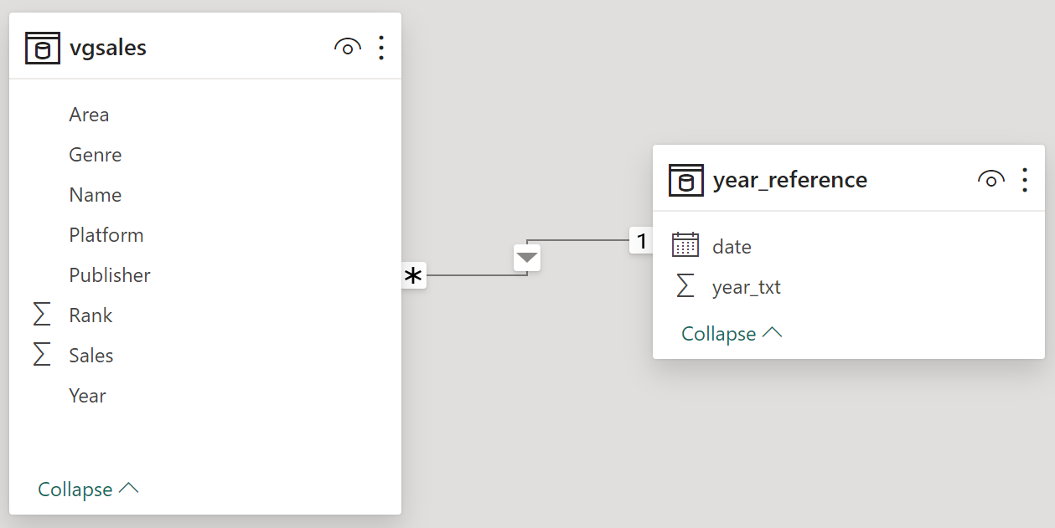
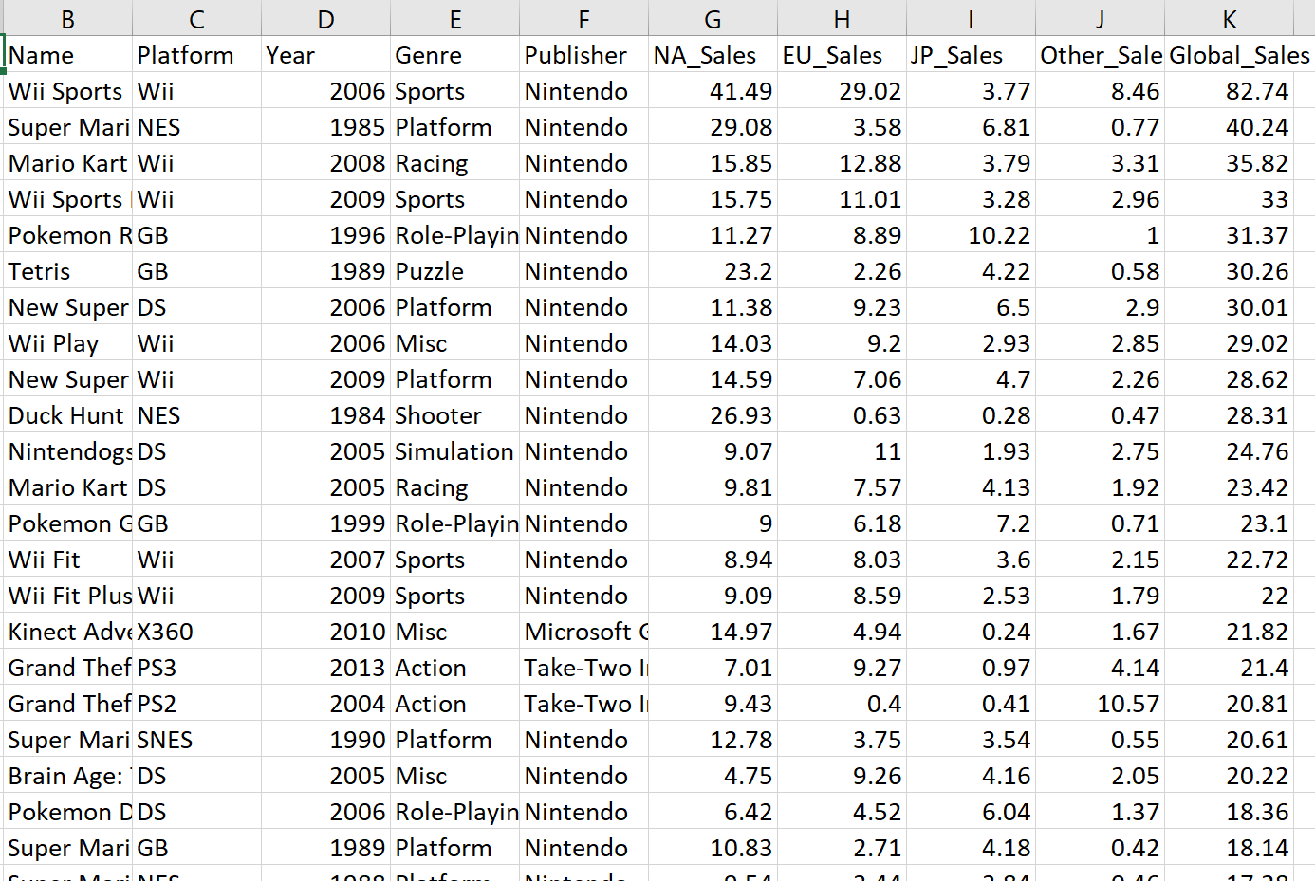
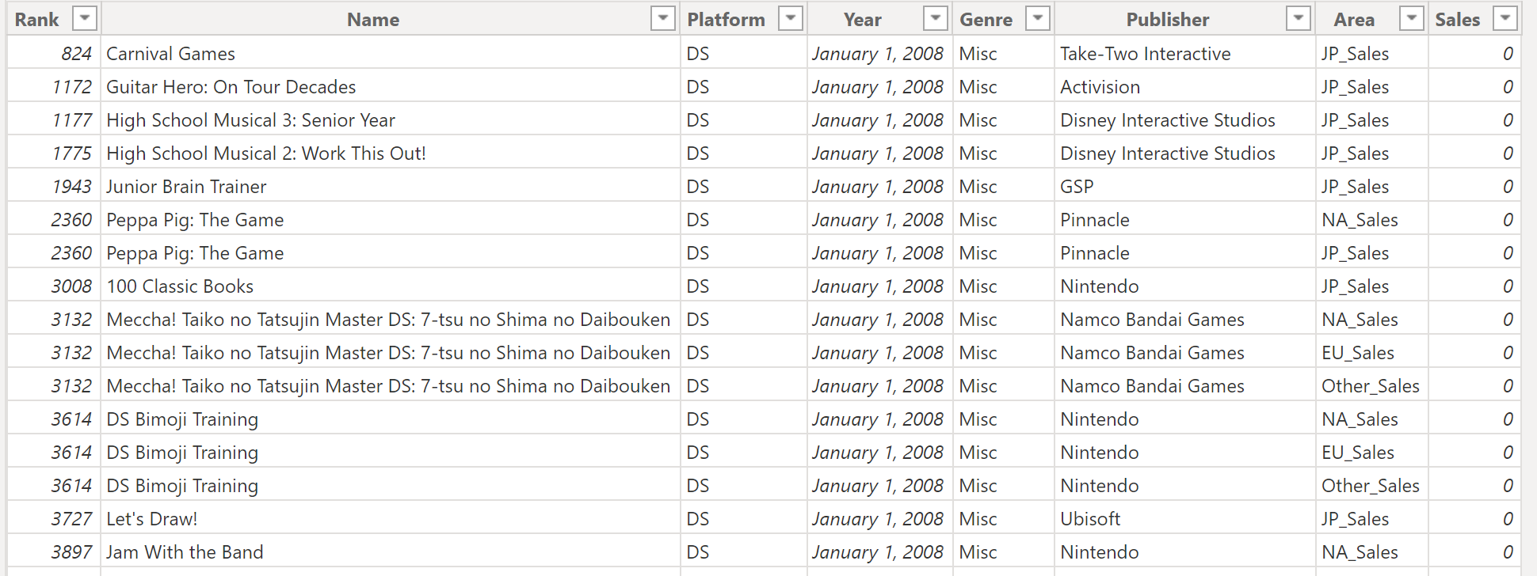
Data Preparing
Data cleaning
Build Reference Table

Slide 6
After cleaning
After doing some simple cleaning:
Area
Genre
Name
Platform
Publisher
SumofRank: add all the ranks (Ranking of overall sales) (Lower = better)
SumOfSales: all the sales added together
Year

Slide 7
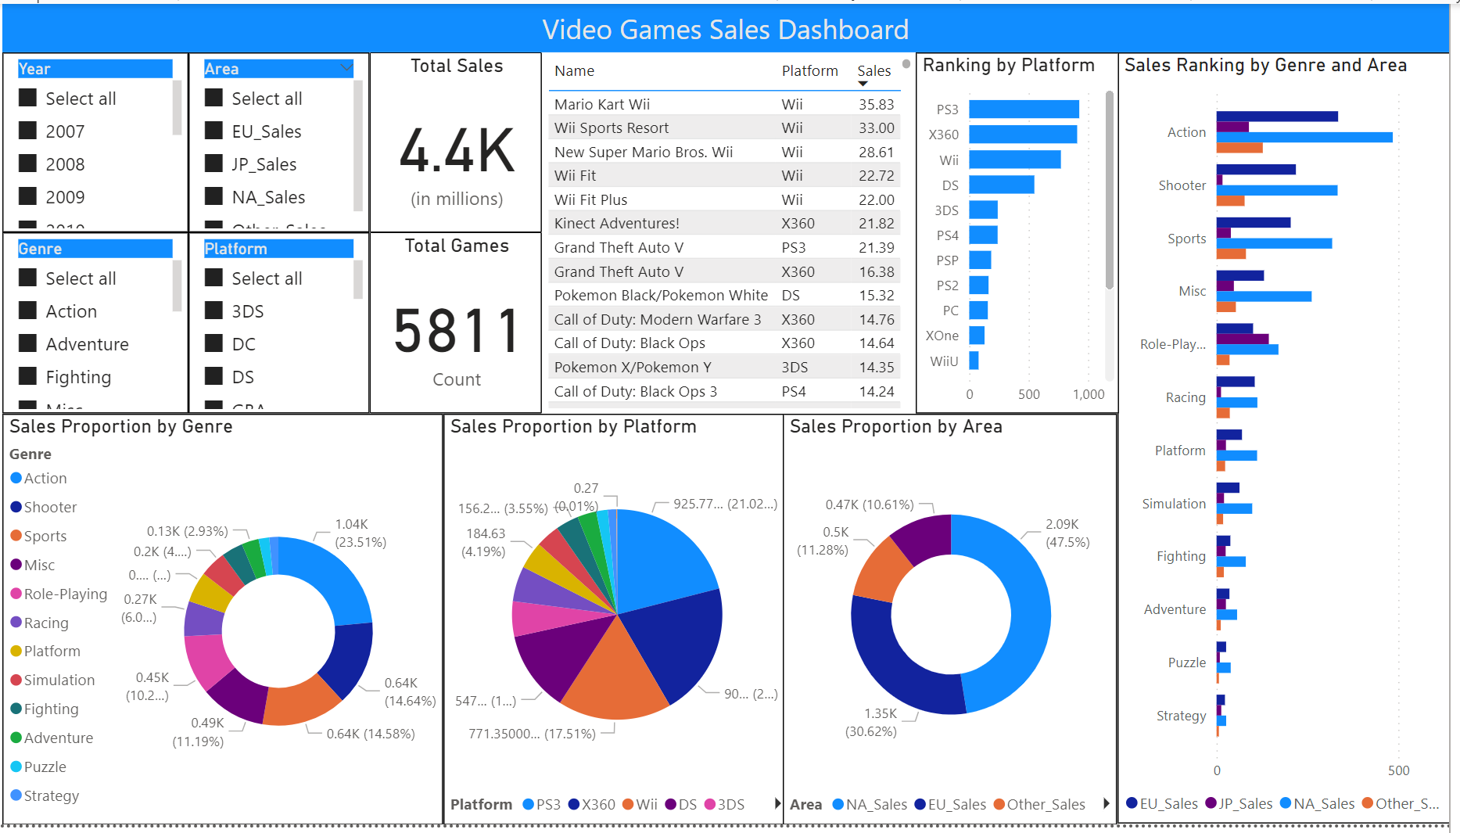
Power BI Dashboard

Slide 8
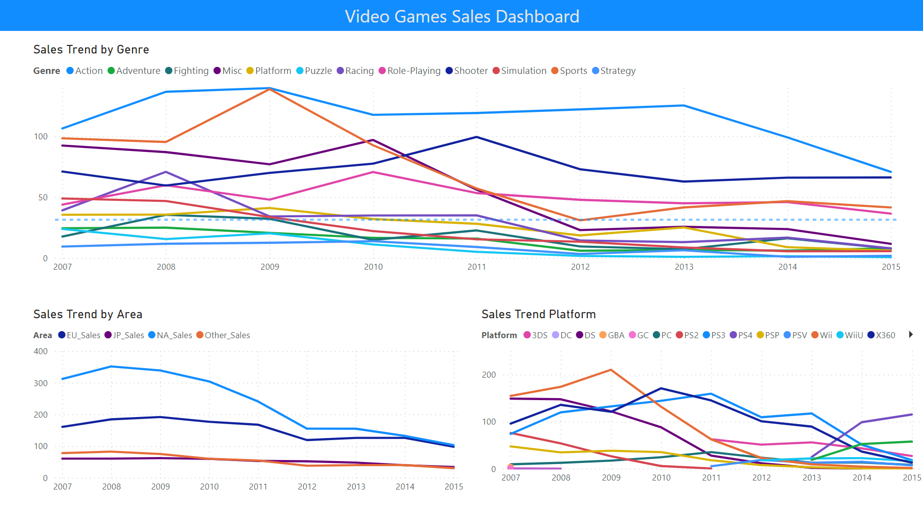
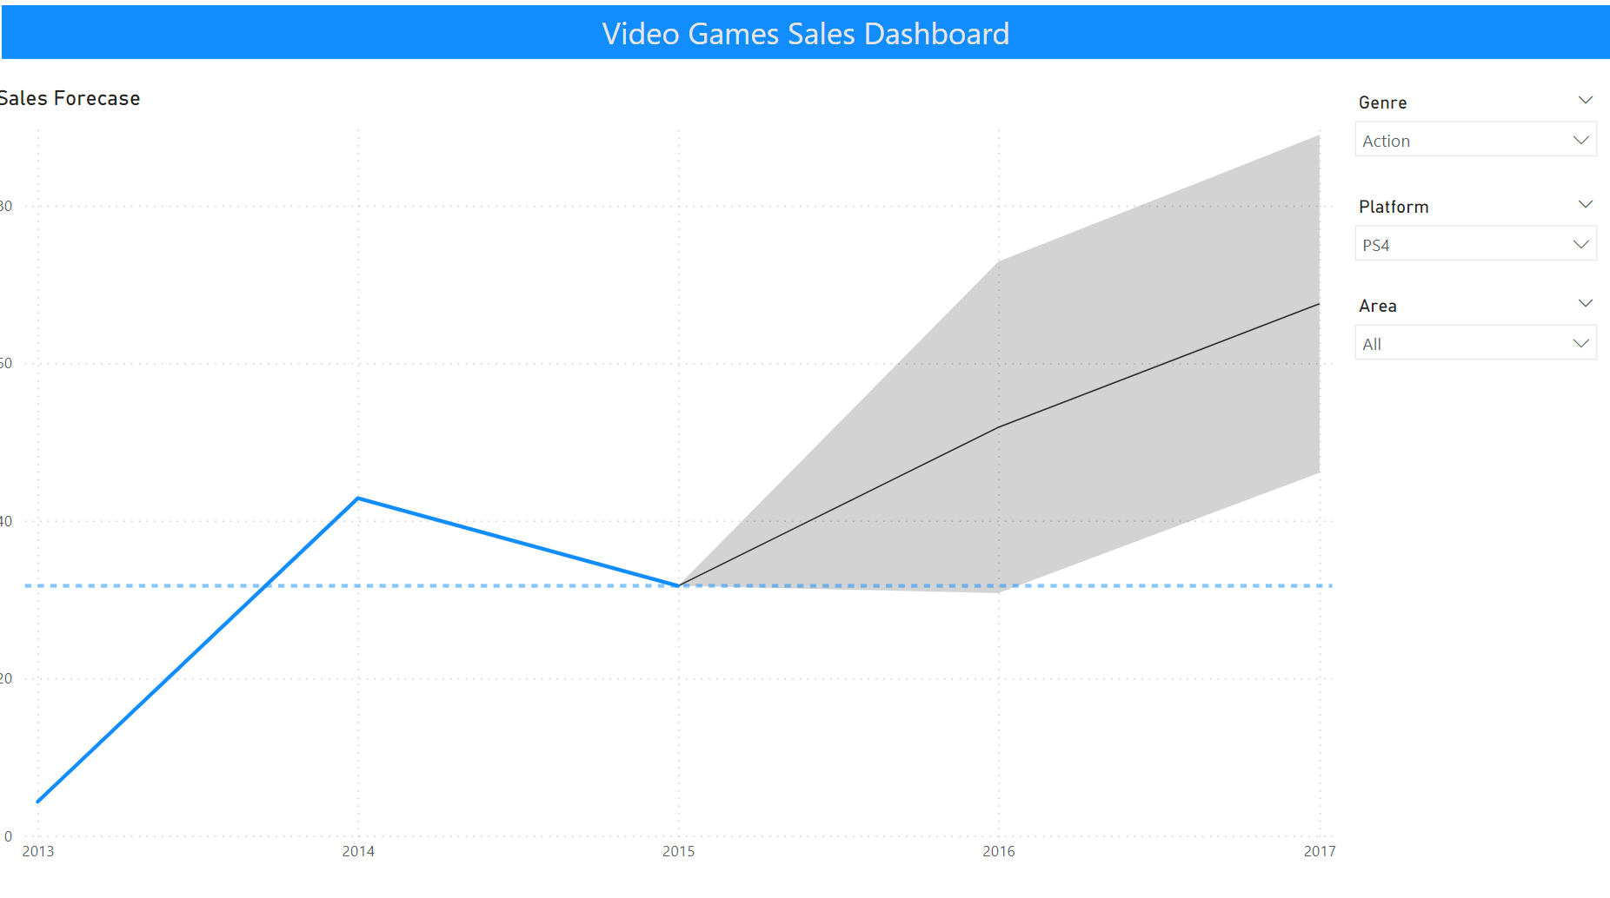
Power BI Dashboard

Slide 9



Types Of graphs And & their Observations

Slide 10
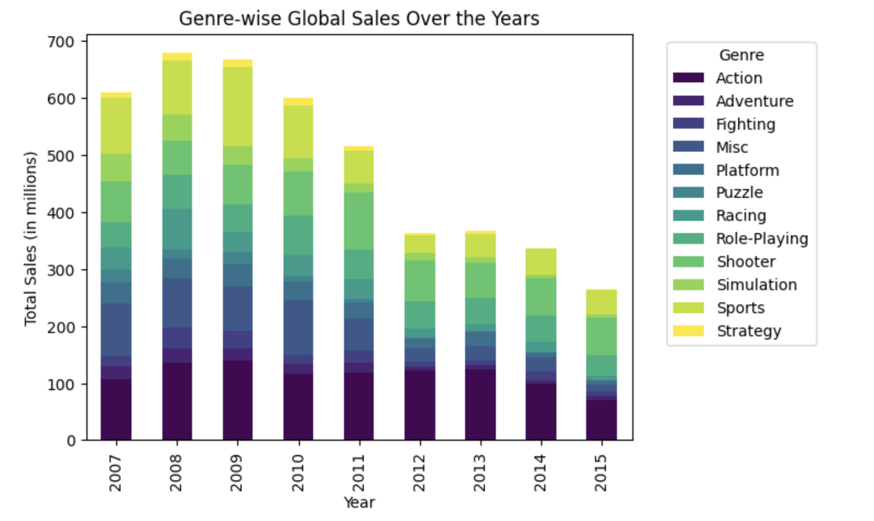
The Global Sales of Genres

Slide 11
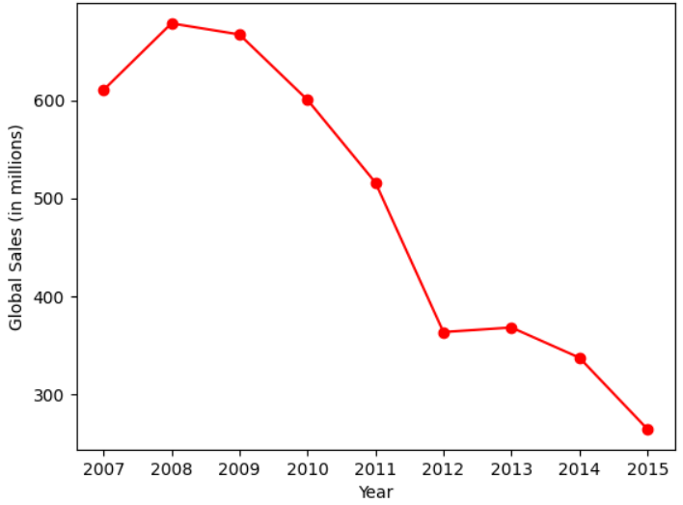
The Global Sales over the years

Slide 12
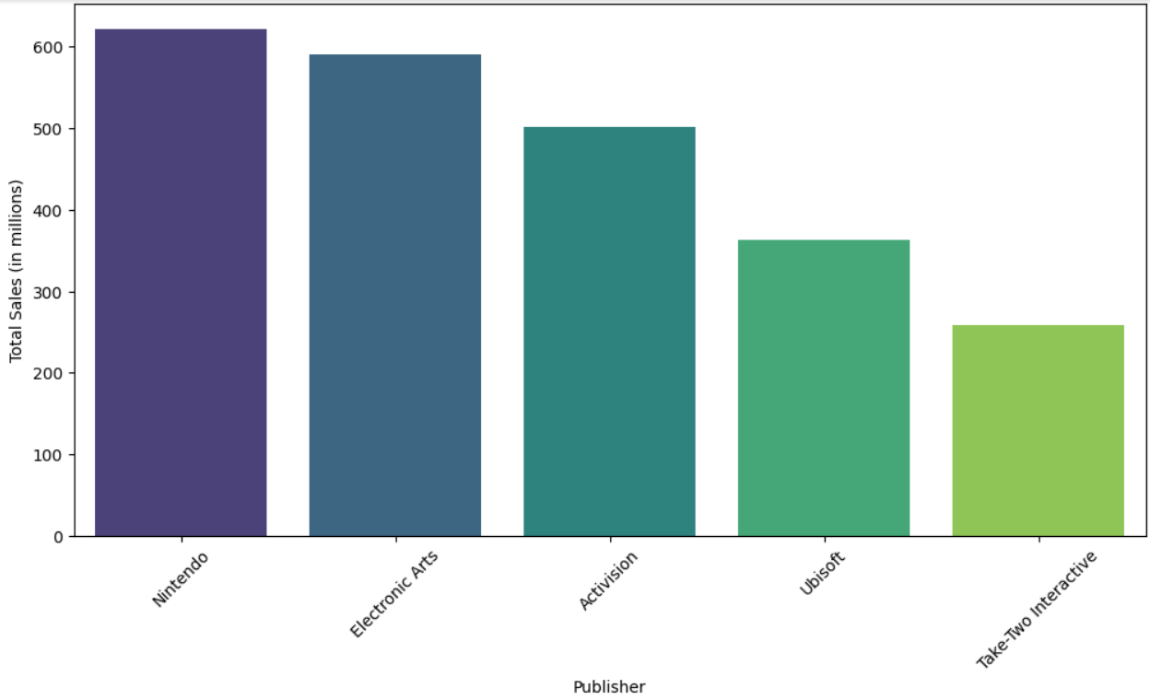
Top 5 Selling Publishers

Slide 13
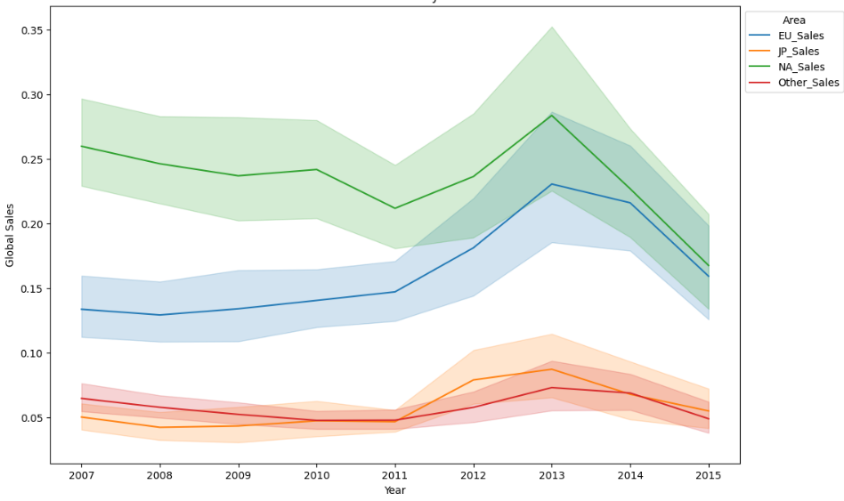
Sales Over Time By Area

Slide 14
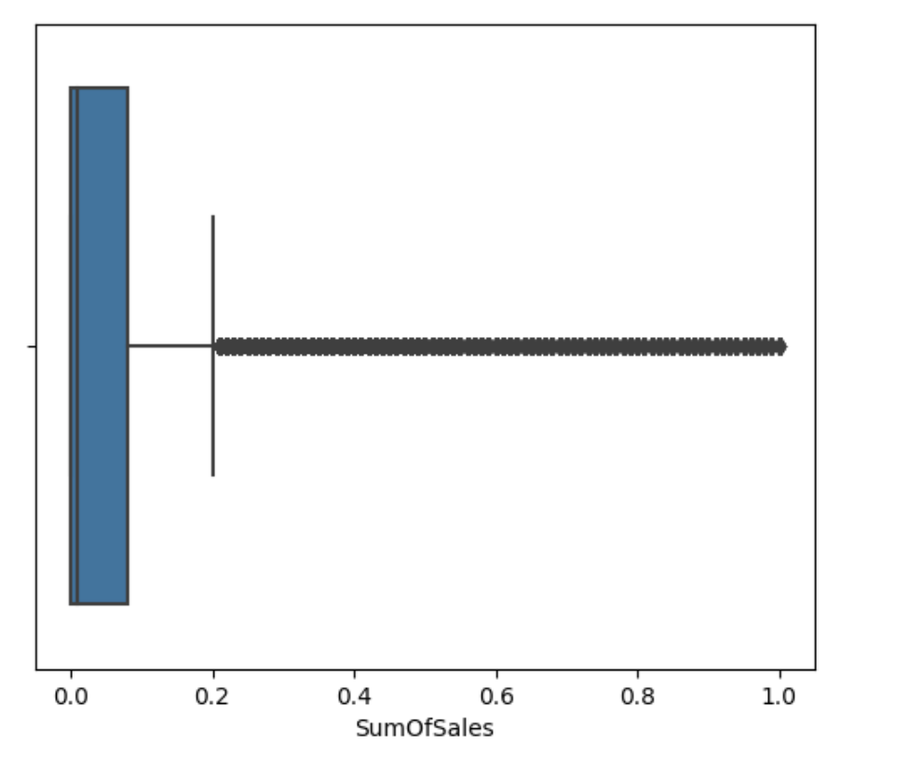
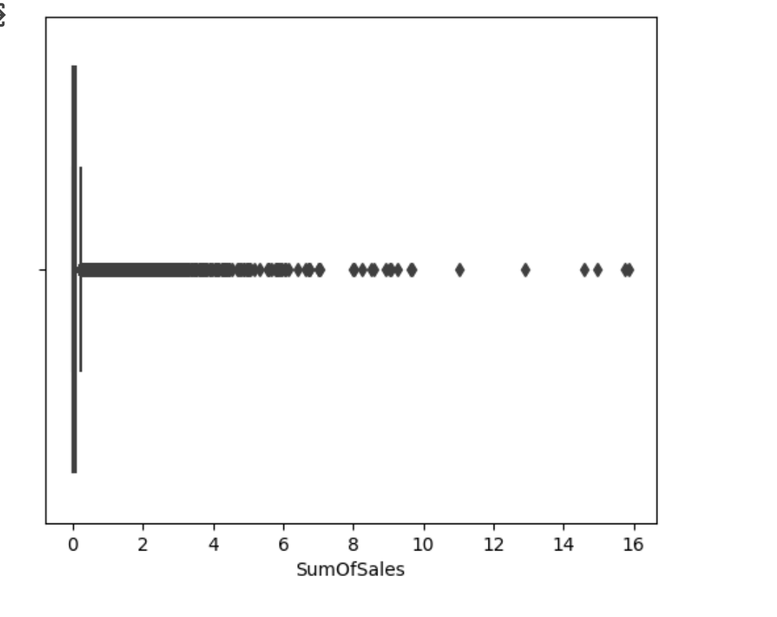
Predictive Statistics(REGRESSION)
Target Variable (y): "SumOfSales"
Features
Area
Genre
Platform
Publisher
SumofRank
Year
Cleaning

Slide 15
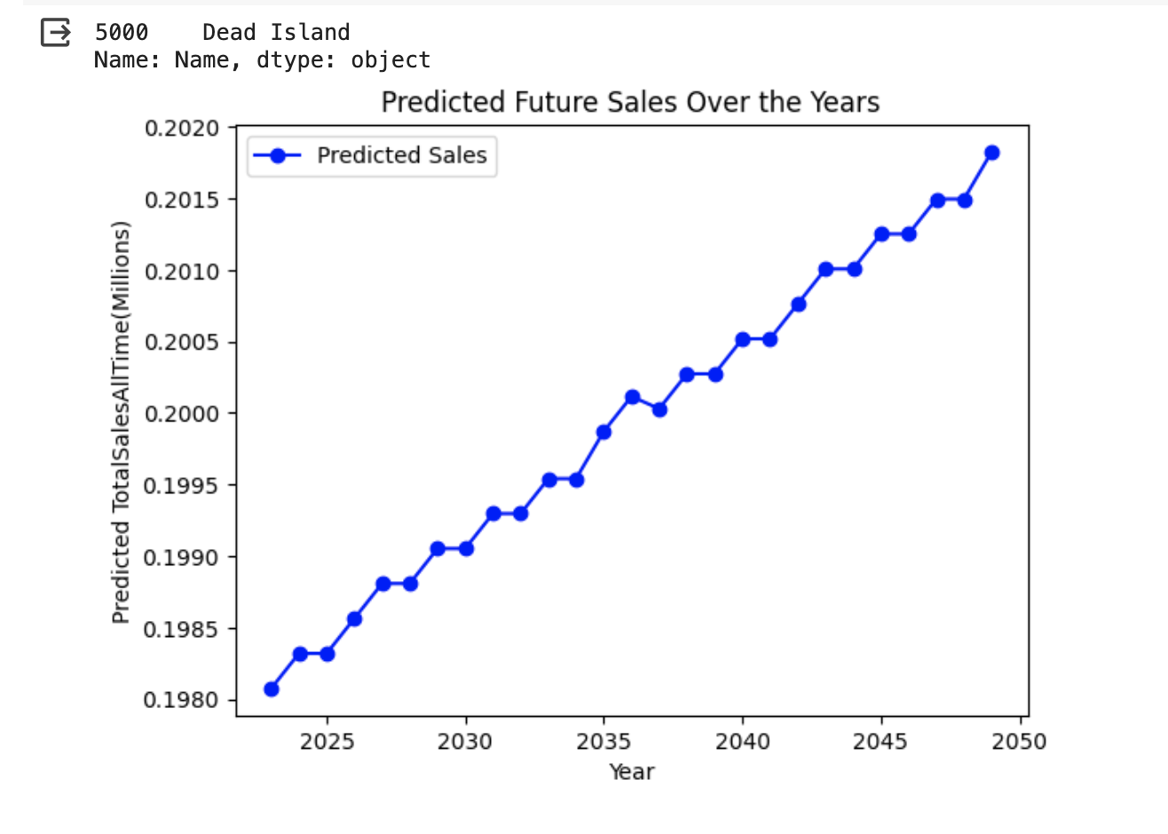
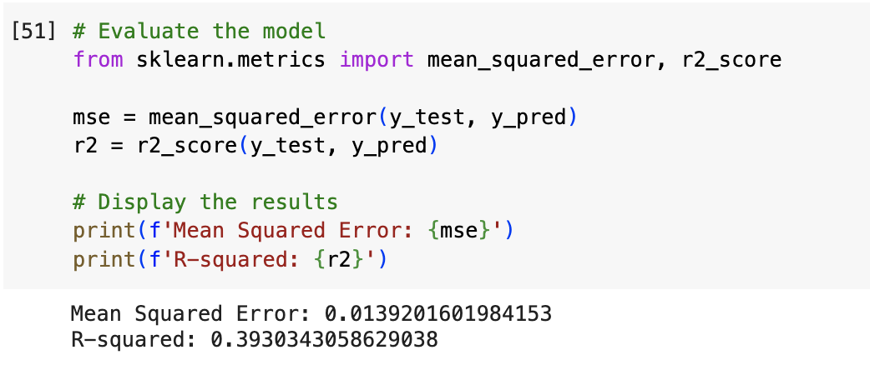
PREDICTIVE STATISTICS(REGRESSION)
LinearRegression graph:

Slide 16
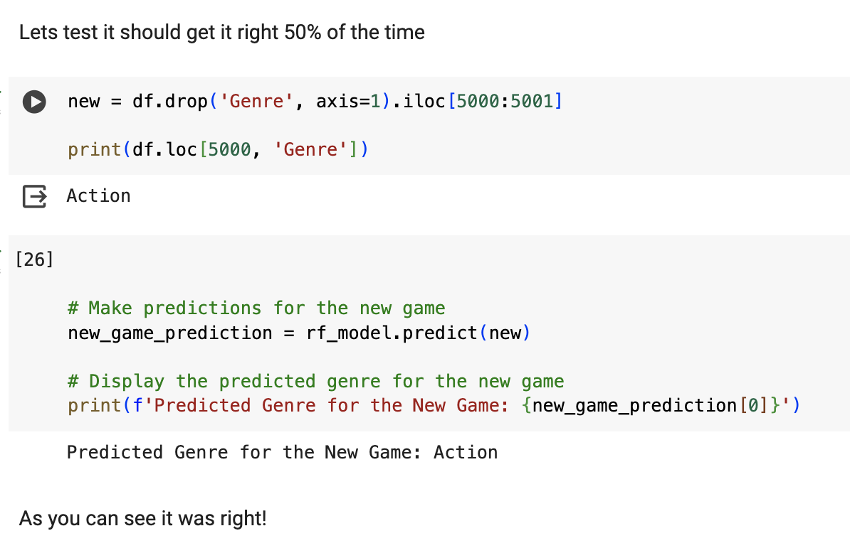
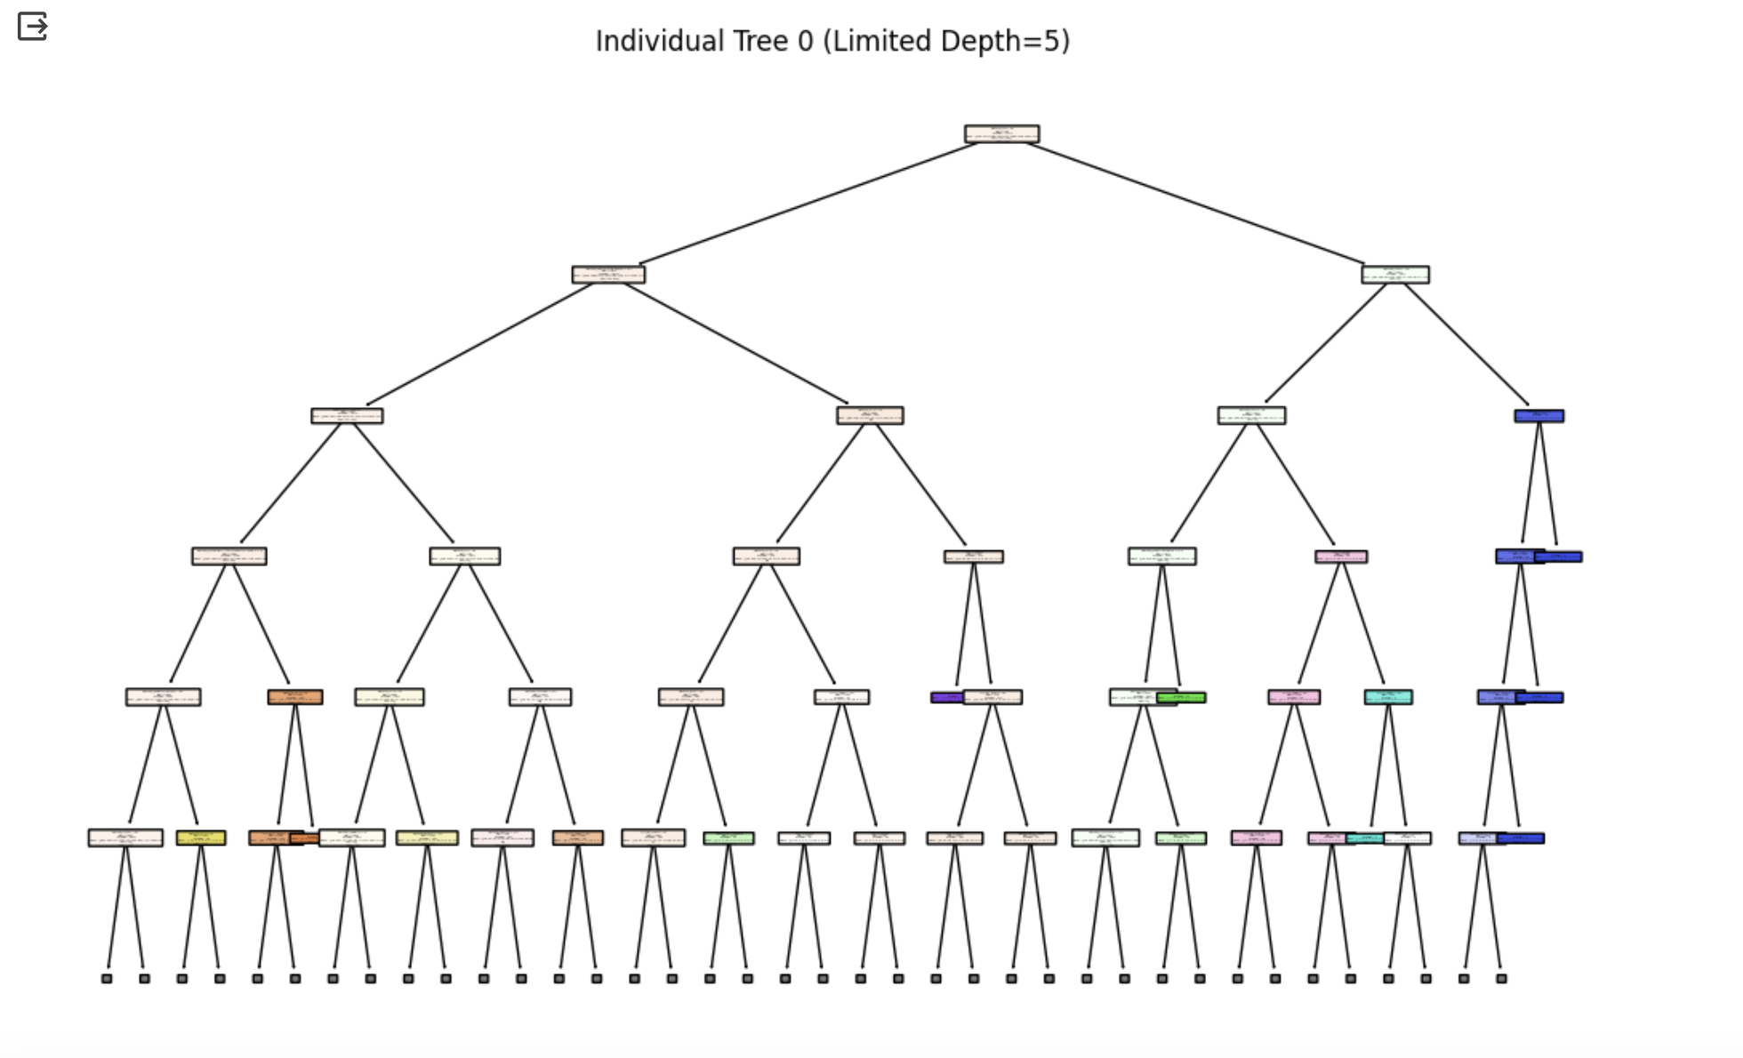
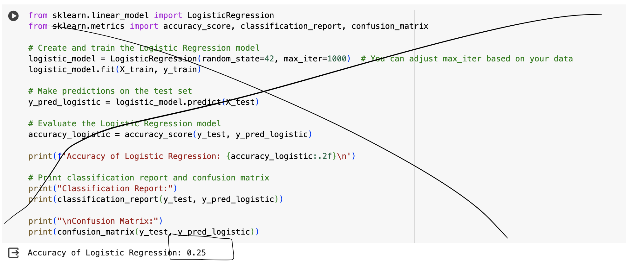
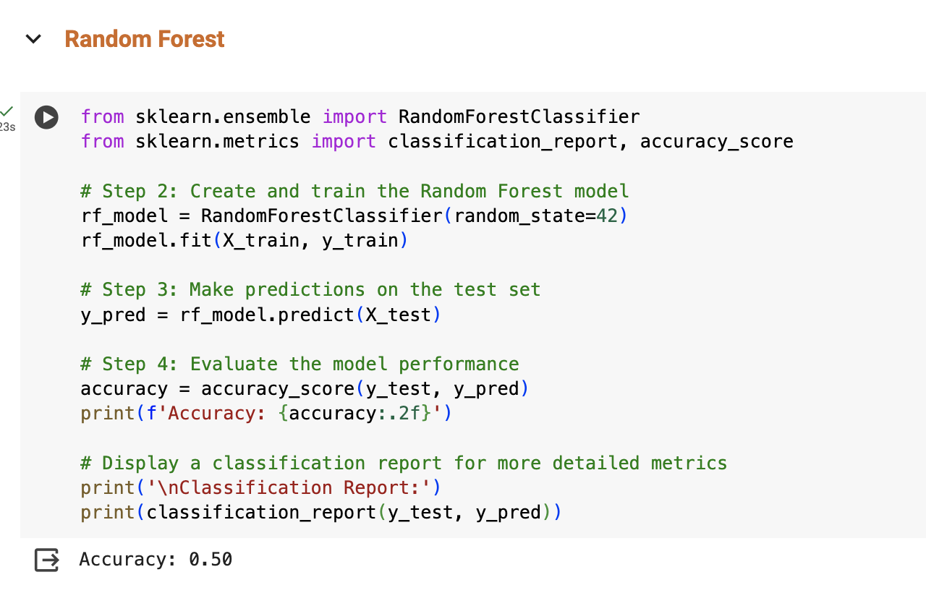
PREDICTIVE STATISTICS(CLASSIFICATION)
Testing:
Random rainforest
Target Variable (y): "Genre"
Features
Area
Name - removed since rainforest does not work with it
Platform
Publisher
SumofRank
SumOfSales
Year
Logistic Regression:

Slide 17
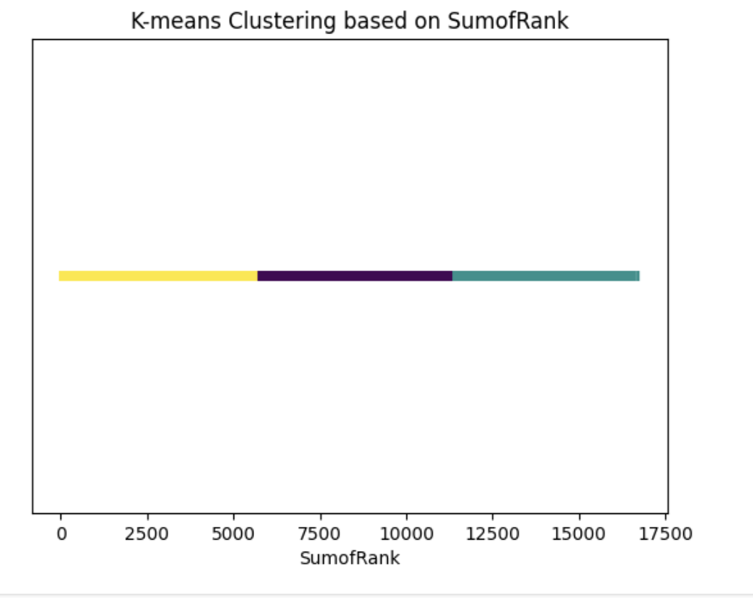
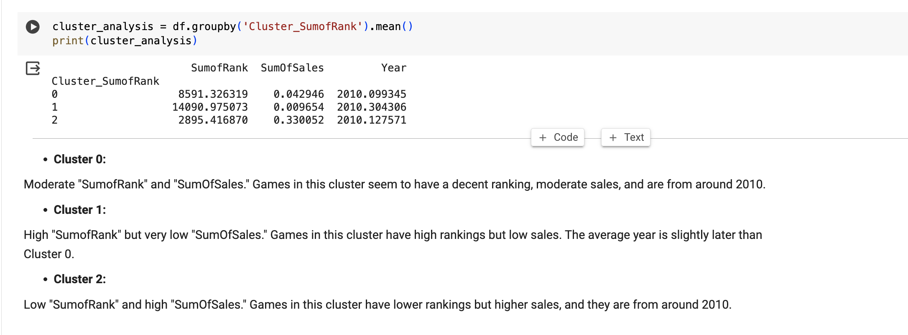
PREDICTIVE STATISTICS(CLUSTERING)

Slide 18
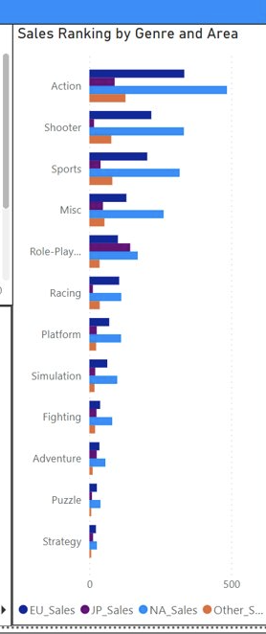
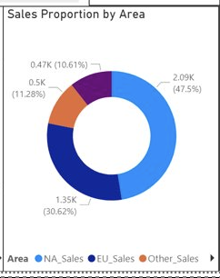
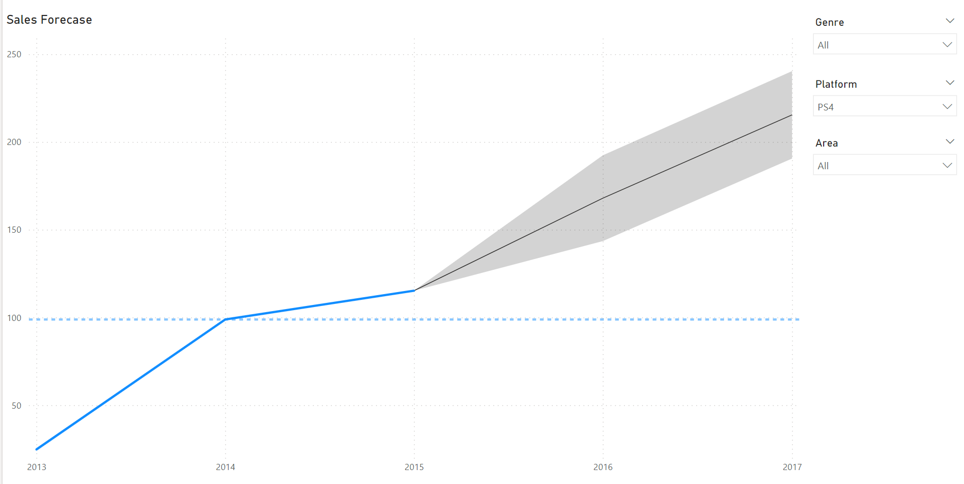
Conclusion and recommendations
From this seems like action games are game we should invest in.
PS4 platform has better prospects, and we should develop more games on the PS4 platform in the future.
We can also see that North America is where we should focus our advertising.
It seems like EU sales are not very high so we should spend more time advertising to NA and EU

Slide 19


